Slide 1
Arabic_TalkBot Natural Language Processing
Nagham Alotaibi – 202110560
Kinda Dardese – 202110811
Supervised by:
Dr. Hossam Mustafa

Slide 2
01
Introduction

Slide 3
we aim to develop an interactive chatbot to create an interactive chatbot tailored for aiding users in learning and honing their Arabic language skills. Central to this endeavor is the integration of the Google Text-to-Speech (gTTS) library within Python, enabling the chatbot to deliver precise pronunciations of Arabic letters, words, and phrases. By harnessing this technology, users can actively engage with spoken Arabic, listening to and practicing pronunciation with confidence. Moreover, our chatbot utilizes the speech_recognition library to seamlessly convert user speech into text. This crucial functionality allows the chatbot to evaluate the user's pronunciation against the correct pronunciation, providing immediate feedback on accuracy. Through this feedback loop, users can iteratively refine their pronunciation skills, fostering a dynamic and effective learning experience in Arabic language acquisition.

Slide 4
02
Challenges

Slide 5
Challenges Faced
01
Dialect and Language Variability
02
Accurate Speech Recognition
03
Natural Language Understanding

Slide 6
03
Conversation Mode Selection System

Slide 7
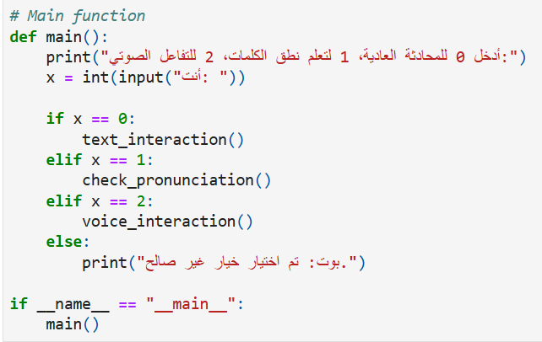
This main function offers users three options: regular text interaction (0), checking pronunciation (1), or voice interaction (2). It prompts the user to input their choice and executes the corresponding function based on the input.

Slide 8
04
Regular Text Interaction

Slide 9
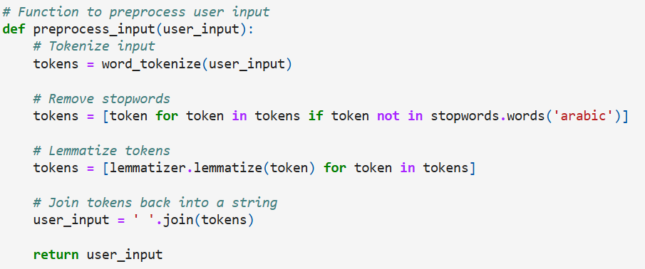
preprocesses user input for the Arabic language. Initially, it tokenizes the input using the `word_tokenize` function from the NLTK library. Subsequently, it removes stopwords using a predefined list of Arabic stopwords from NLTK. Then, it lemmatizes each token using the initialized lemmatizer. Finally, it rejoins the tokens into a string and returns the preprocessed user input. This preprocessing enhances the chatbot's ability to understand and respond appropriately to user queries by standardizing and simplifying the input text.

Slide 10
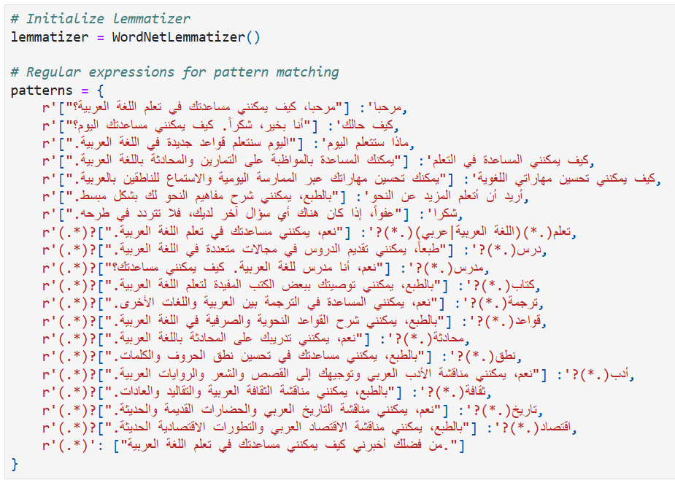
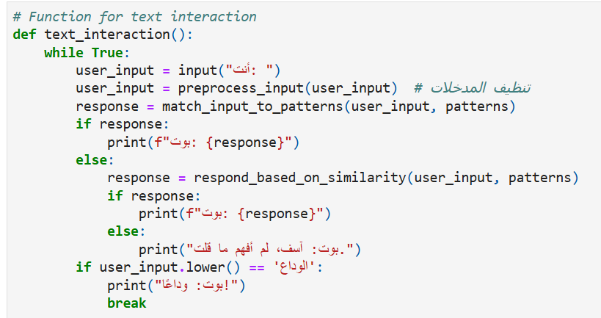
The programmed chatbot helps in learning the Arabic language. It uses a lemmatizer to normalize words and a set of regular expressions to match user inputs with appropriate responses. Each pattern corresponds to a user's query. The provided text_interaction() function facilitates interaction with the chatbot by continuously prompting the user for input, pre-processing it, and then generating appropriate responses based on pre-defined patterns or semantic similarity.

Slide 11
05
Checking Pronunciation

Slide 12
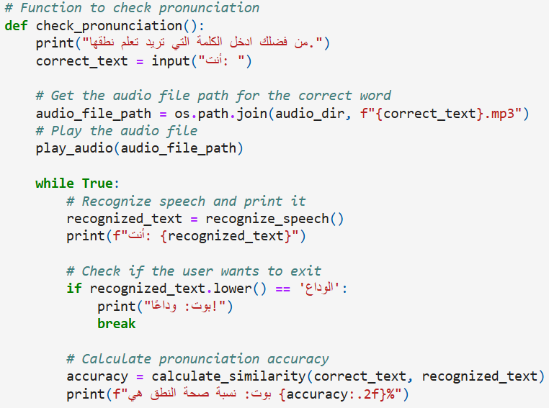
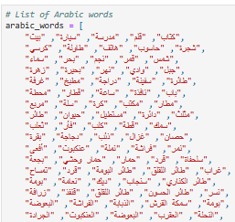
This function allows users to check the pronunciation of Arabic words. It prompts the user to input a word and plays its audio pronunciation. Then, it continuously recognizes the user's speech input, calculates the pronunciation accuracy compared to the correct word, and provides feedback.

Slide 13


Files for Arabic words

Slide 14
06
Voice Interaction

Slide 15
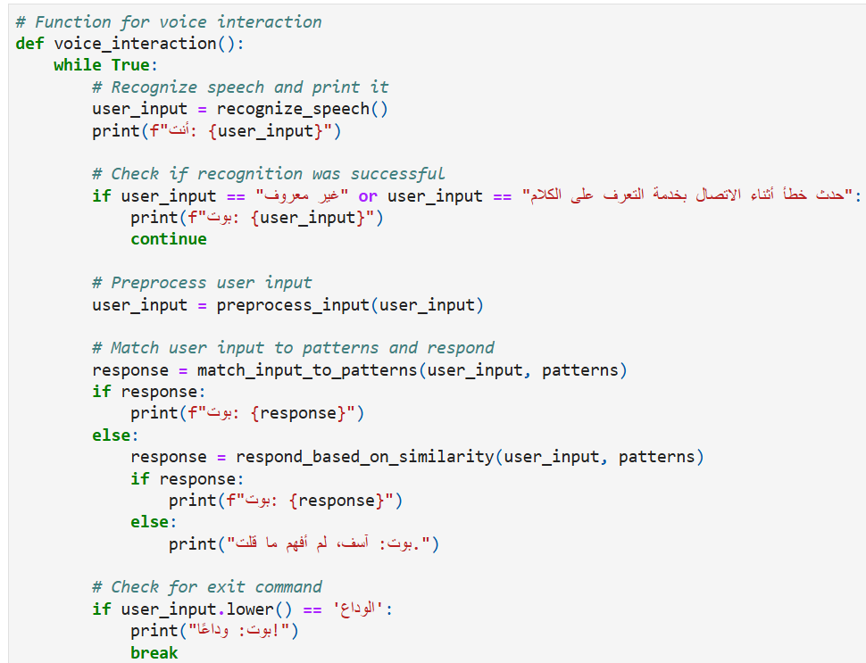
This function enables voice interaction with the chatbot. It continuously recognizes speech input from the user and prints it. If recognition fails or encounters an error, it notifies the user accordingly. The function preprocesses the user input, matches it to predefined patterns, and generates responses. If no direct match is found, it attempts to respond based on similarity with existing patterns.

Slide 16
07
conclusion

Slide 17
In conclusion, our exploration delved into evaluating the efficacy of a compact code snippet tailored to facilitate language learning and pronunciation refinement. Leveraging libraries for text-to-speech conversion, speech recognition, and string similarity comparison, the code orchestrates a user-friendly interface for Arabic learners. By prompting users to input Arabic sentences, playing corresponding correct pronunciations, and assessing users' pronunciation similarity, the code fosters an interactive platform for pronunciation practice. While the code exhibits fundamental functionality, there remains scope for enhancement, particularly in bolstering speech recognition accuracy and enriching user feedback mechanisms. Nevertheless, as a foundational tool for language learners, it provides a stepping stone for honing Arabic speaking skills through engaging practice sessions and iterative improvement efforts.

Slide 18


